Slide 1
FRAUD AND RESIDENTIAL TITLE INSURANCE FOR COLLOQUIUM 2022

Slide 2
Law Society Obligations
You are required by the rules of professional conduct to be on guard against fraud.

Slide 3
Agenda
Notes:
Law Society Obligations
Types of Fraud & Red Flags
Fraud Prevention Tips
Private Lenders
Title Insurance Fraud Coverage

Slide 5
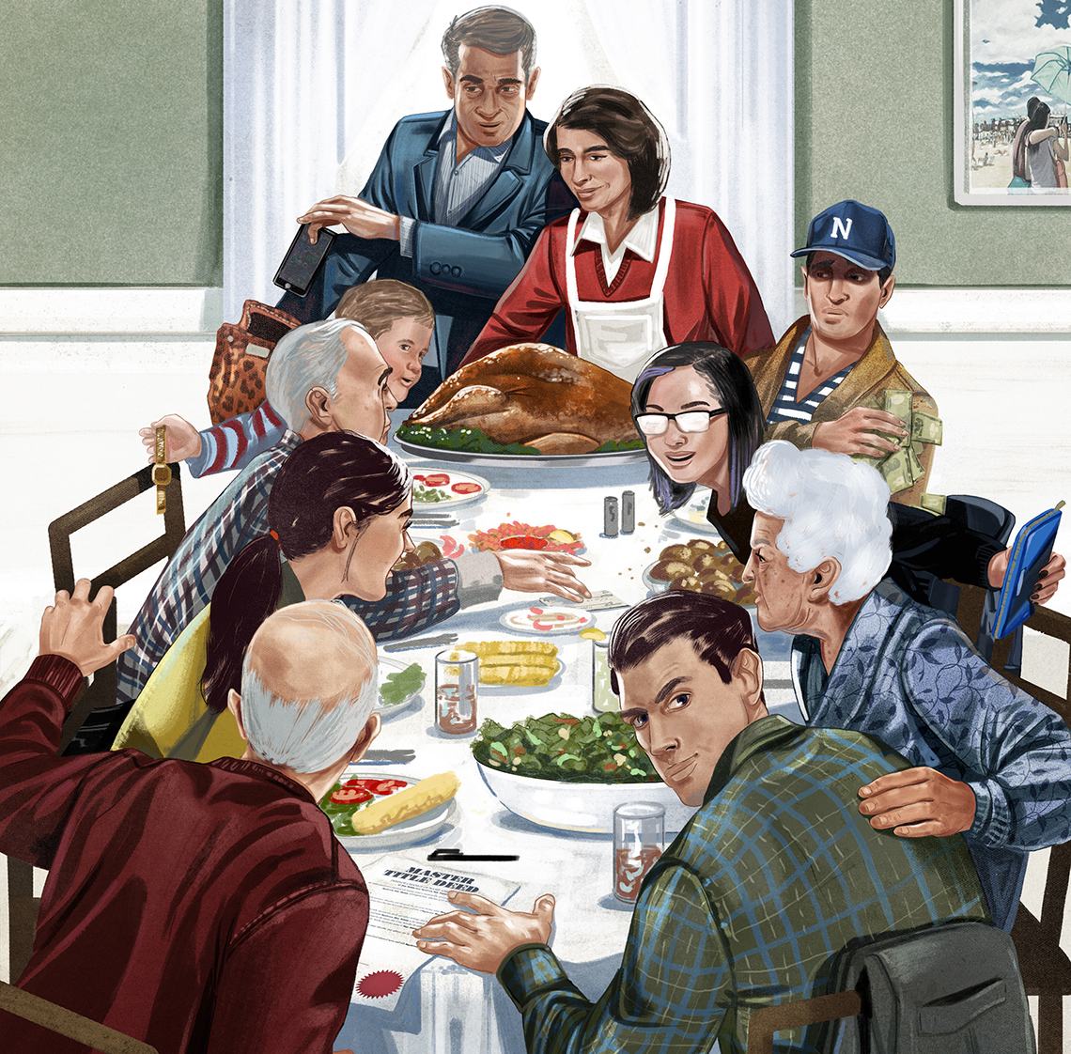
Notes:
Identity fraud may be committed by someone the victim knows.

Slide 6
Fraud Claim

Slide 7
Vendor Impersonation

Slide 8
ID Verification

Slide 9
Sudbury-and-area Coverage

Slide 10
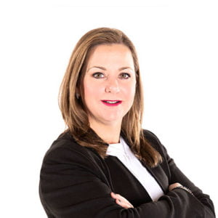
Contact Us!
Sarah McDonald| North GTA & Northern Ontario
Phone: 1 (888) 220-0514 e-mail: smcdonald@ctt.com

Slide 11
FRAUD AND RESIDENTIAL TITLE INSURANCE FOR COLLOQUIUM 2022

