Slide 1
Navigating
Governance Challenges
in Closely Held Companies
Colloquium Sudbury 2022
October 21, 2022

Slide 2

Today’s Session
Overview of governance legal principles
Case studies: Common sources of conflict in closely held companies and what professional conduct issues often arise for counsel in those situations
Lessons for how these conflicts can be avoided and resolved, in and out of court

Slide 3

Overview of Corporate Governance Legal Principles

Slide 4
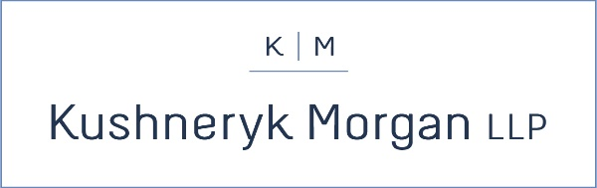
Mandatory obligations under the law
Why do legal building blocks of governance matter?
Common ground rules for behaviour
Good governance is good business

Slide 5
Corporations, partnerships, trusts, etc. are independent of the individual people who carry out their actions;
Corporate structures as independent entities
Entities can owe and be owed their own obligations, rights and duties

Slide 6
Ownership
(shareholder),
Difference between
the three:
Oversight
(board of directors)
Operations
(executive management)
Shareholders elect Board
            Board oversees Management
                Management operates business day-to-day

Slide 7

Corporate Governance
Legal Principles (cont’d)
Governance statutes and instruments
corporation statutes, special acts, letters patent, unanimous shareholder agreements, by-laws, policies, trust indentures, partnership agreements
Role and significance of statutes and instruments
among shareholders, directors, management and family
members in all capacities

Slide 8
Corporate Governance
Legal Principles (cont’d)
Directors’ duties
Fiduciary duty:
act honestly and in good faith with a view to the best interests of the corporation
Duty of care:
exercise the care, diligence and skill that a reasonably prudent person would exercise in comparable circumstances
See:
Business Corporations Act, RSO 1990, c B.16, s. 134
Canada Business Corporations Act, RSC 1985, c C-44, s. 122
BCE Inc. v. 1976 Debentureholders, 2008 SCC 69
Peoples Department Stores Inc. (Trustee of) v. Wise, 2004 SCC 68

Slide 9

Key Rules of Professional Conduct and
Ethical Duties

Slide 10

Duty to avoid conflicts of interest (Rule 3.4-1)
    Need to determine who your client is (company or individual, in what capacity?)
Duty to maintain confidentiality (Rule 3.3-1)
Duty to be honest and candid (Rule 3.2-2)
Managing joint retainers (Rule 3.4-5)
Conducting effective client interviews and client meetings
Practicing with civility in the courtroom and the boardroom

Slide 11

Case studies

Slide 12


Scenario 1 –
Re Ferguson and Imax Systems Corp., (1983), 43 OR (2d) 128
Illustrates the challenges of changing relationship dynamics for closely held companies.
Three couples held shares in Imax at start-up. The work building the company was undertaken by the three men and one of the men’s wives, Betty Ferguson.
When Ivan Graeme Ferguson and Betty Ferguson divorced, the company ceased paying dividends for the purpose of denying Betty Ferguson the benefits.
The company’s ability to reward investors and recruit and incentivize new employees was constrained.
Company tried to re-structure to squeeze out Betty Ferguson.

Slide 13
Scenario 1 –
Re Ferguson and Imax Systems Corp., (1983), 43 OR (2d) 128
Court of Appeal held:
  Here we have a small close corporation that was promoted and is still controlled by the same small related group of individuals. The appellant's part in that group and her work for the corporation is important. Further, the attempt to force her to sell her shares through non-payment of dividends was not simply the act of Mr. Ferguson, but was also the act of the others in the group including the present director, in concert with him. Having regard to the intention of that group to deny the appellant any participation in the growth of the company I think the resolution authorizing the change in the capital of the company is the culminating event in a lengthy course of oppressive and unfairly prejudicial conduct to the appellant.

Slide 14
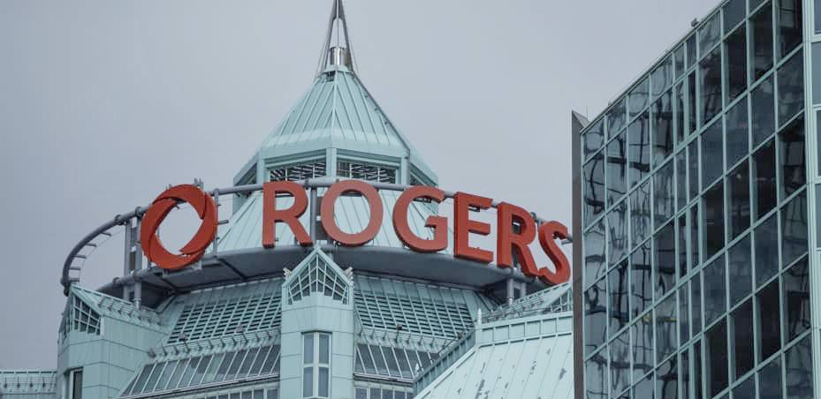
Scenario 2 –
Rogers v Rogers Communications Inc., 2021 BCSC 2184
Widely-held public company; dual class share structure; family shares held in a trust
Disagreement on whether CEO should be removed
Edward Rogers sought to remove and replace five company directors through written consent resolution

Slide 15
Scenario 2 –
Rogers v Rogers Communications Inc., 2021 BCSC 2184
As chair of Rogers family trust, Edward could vote the trust shares
Edward passed resolution and installed his preferred directors
Dueling boards, both claiming to be true Rogers board
Interpretation of Rogers’ Articles of Incorporation and the BC statute under which Rogers incorporated
Court found Edward had properly brought and passed consent resolution, meaning his slate of directors duly elected

Slide 16
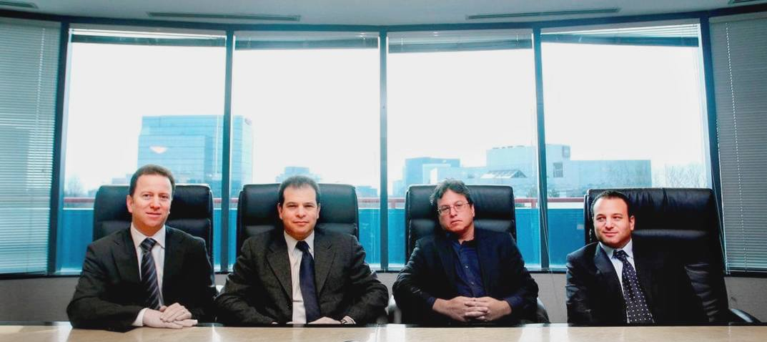
Scenario 3 –
Libfeld v. Libfeld,
2021 ONSC 4670
Real estate development company
Founded 1951
Value $2.5 to $4 billion
No shareholder or partnership agreement

Slide 17
Scenario 3 –
Libfeld v. Libfeld,
2021 ONSC 4670
Application to wind up business
Main issue was methodology of dissolution:
    Buy-sell remedy or strategic buy out
    Division into four portions
    Total liquidation, wind-up and sale
Result: Group to be wound up and sold under supervision of a Court-appointed sales officer

Slide 18
Scenario 4 –
Hypothetical* –
Divisions on the Board
Company has generally been productive.
Now involved in a dispute with a major supplier.
Board members, who are also the only shareholders, have divided into two camps and are threatening litigation against each other and against the company, making allegations about one director having a romantic relationship with a subordinate, contrary to company policy.
Some of the directors disagree with the direction management is taking the company.
Some directors are considering resigning.
* Hypothetical - based on elements of real client matters

Slide 19

Avoiding and Resolving Conflicts

Slide 20
Dispute resolution tools
    Mediation: non-binding, confidential discussions and negotiations facilitated by a third party
    Litigation: court process in public for dispute resolution
    Arbitration: confidential, binding dispute resolution process
    Independent counsel: lawyers unconnected to any party to assist, advise and investigate

Slide 21

What preventative measures are available?
Corporate governance training
Clear written agreements that reflect shared understanding and purpose (ownership, operations, roles, succession)
Pre-dispute risk management (not tainted by the atmosphere of a dispute)
Professional advice (directors, advisors, counsel) before issues escalate

Slide 22
ads are charged with managing or overseeing the management of the business and affairs of the corporation
Boutique law firm with expertise in corporate governance, dispute resolution and securities litigation and enforcement
www.kmcounsel.ca
Susan Kushneryk
Former enforcement counsel at Ontario Securities Commission, Investment Industry Regulatory Organization of Canada
Previously with Torys LLP and Hansell LLP in Toronto
Eric Morgan
Previously with Osler LLP in Toronto and Freshfields in London
About Kushneryk Morgan LLP

Slide 23
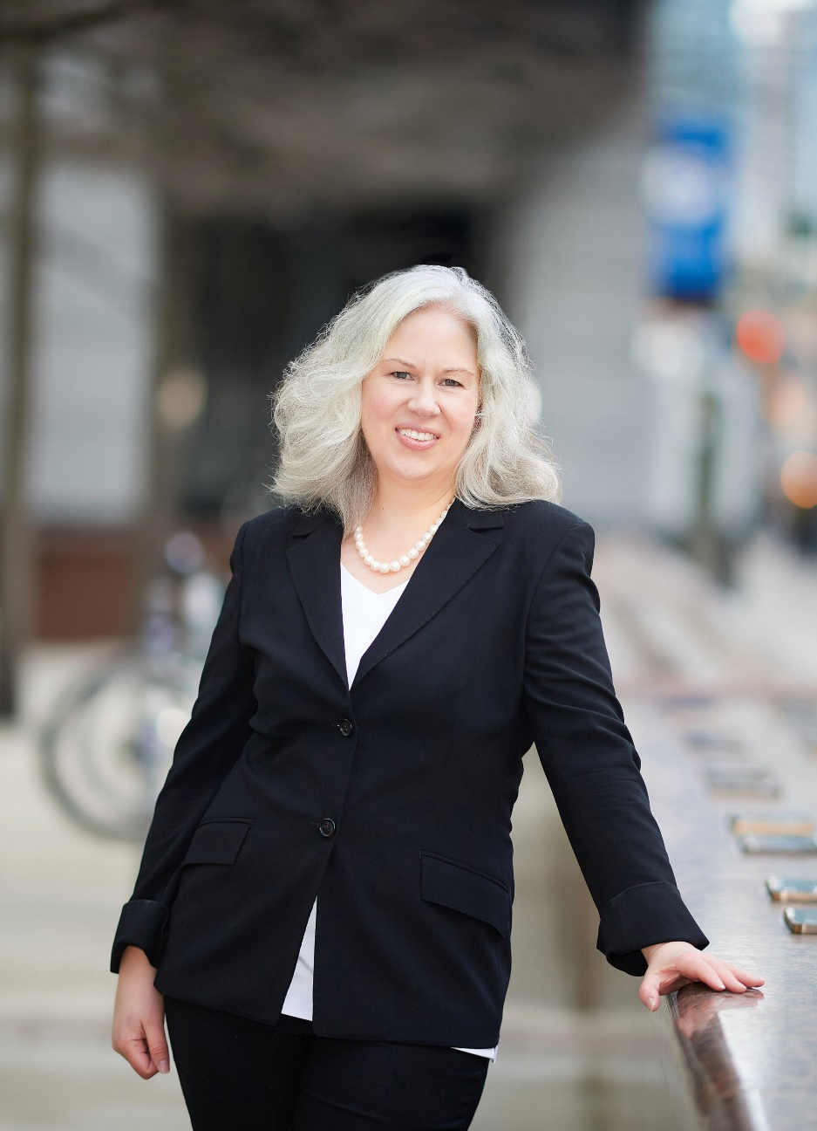
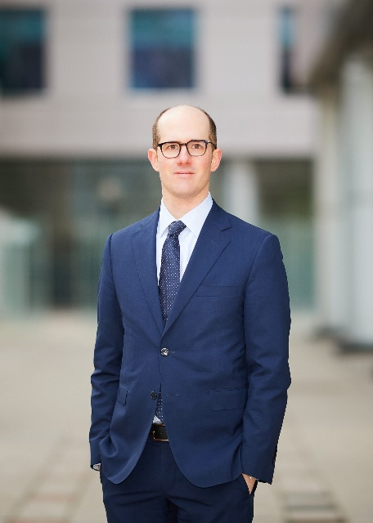
Contact Kushneryk Morgan LLP
Contact Kushneryk Morgan LLP
Susan Kushneryk
647.317.1526 x1
skushneryk@kmcounsel.ca
Eric Morgan
647.317.1526 x2
emorgan@kmcounsel.ca

