Slide 1
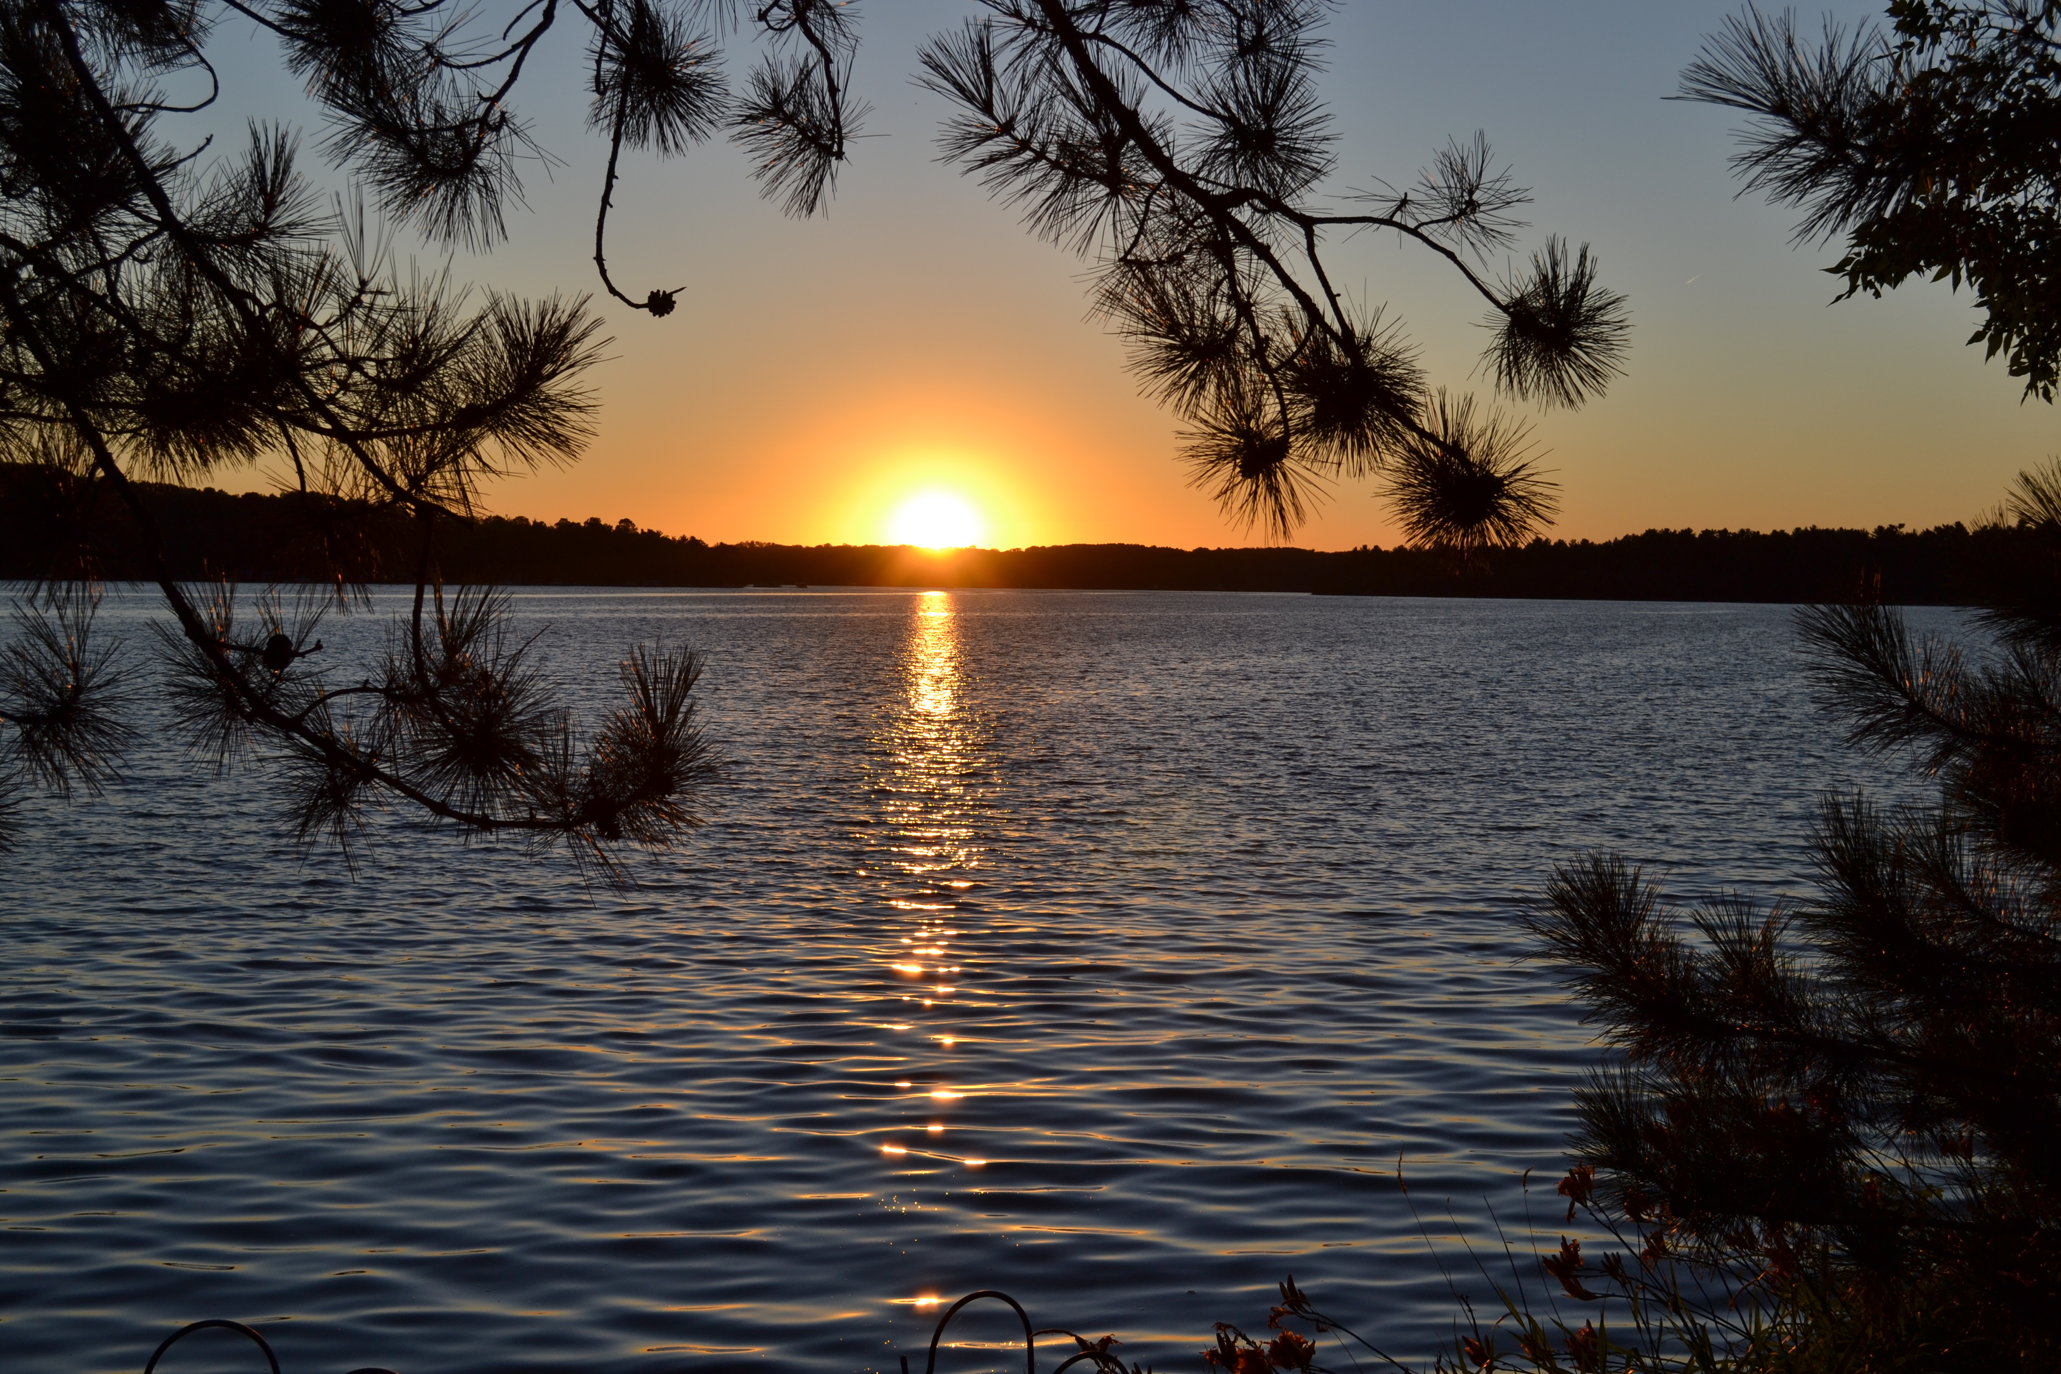
COTTAGE SUCCESSION
Planning to Reduce Risks and Taxes
Notes:
Most cottagers would love to ensure their children and grandchildren have the opportunity to participate in the pleasures of cottage life.
Increasing demand and rapidly rising waterfront real estate prices mean most children won’t be able to buy their own. Finding a way to pass along your cottage may be the only realistic option for future generations to share this extraordinary life experience.
This conclusion is confirmed by research conducted by Ipsos Reid:
81% of cottage owners say they plan to pass the cottage to other family members
22% of cottage owners agree that the shared cottage is likely to cause a rift in the family
11% admit it has already caused a family rift
The problem is that a punitive tax system, harsh financial realities and predictable family frictions are all critical obstacles to keeping your family in the cottage.

Slide 2
OVERVIEW
COTTAGE SHARING AGREEMENT
JOINT PARTNER TRUST
SPRINKLING COTTAGE TRUST

Slide 3
Cottage Sharing Agreements
If shared ownership between generations or among siblings
Restrictions on transfer outside family
Dispute resolution
Exit strategies
Allocation of usage & expenses
Notes:
The best approach to keeping your family in the family cottage is through planning for the eventual cottage succession. For some families the best way is to transfer the cottage while the parents are still alive. One benefit of this is that, although the capital gains tax liability will have to be paid earlier than need be, the amount will be much less than if the tax is much larger at death of the parents, reflecting all of the increases in value in the cottage for the rest of the parents’ lifetimes.
But for most families the preferred method of cottage succession is for the parents to retain ownership during their lifetimes, and pass the cottage on following their deaths. Advantages of this approach is that the parents retain control of the cottage for their lives, and the cottage will not be affected by marital or financial or inter-family issues that affect the children. The eventual capital gains tax to be paid will be larger than if the cottage was transferred during the parents’ lifetime, but usually there are other estate assets (life insurance; proceeds of sale of the house; etc.) to fund the capital gains tax liability arising from the cottage staying in the family.

Slide 4
Trust Overview
Combination of two trusts:
Joint Partner Trust (JPT) protects cottage and parents while they live
Sprinkling Inheritance Trust (SIT) protects cottage and children after death of parents
One legal document contains both the JPT and the SIT
Notes:
For those parents who decide to retain personal ownership of the cottage for their lifetimes, then a combination of a Joint Partner Trust and Sprinkling Inheritance Trust is a very effective and protective way to pass the cottage on to the next generation.
Assets that pass through a probated Will are subject to Estate Administration Tax (often referred to as “probate tax”). This tax is slightly less than 1.5% of the value of the probated assets, and so on a $750,000 estate the Estate Administration Tax would be about $11,000 in Ontario.
This tax can be avoided entirely or substantially reduced if another succession vehicle is utilized, called a Joint Partner Trust (JPT). Your cottage (and non-registered investment assets and city residence if desired) are transferred by you into this trust, and Canadian residents over age 65 may settle such assets upon the trust without triggering capital gains tax. No Land Transfer Tax is paid when the cottage is transferred into the JPT.

Slide 5
Joint Partner Trust
Parents transfer cottage into the JPT:
NO Land Transfer Tax paid
NO capital gains tax paid if parents are Canadian residents over age 65
NO capital gains tax paid upon the death of the first parent
Capital gains tax paid only after both parents have died
Notes:
The trust assets are controlled solely by you during your lifetime (unless or until you choose to involve the assistance of others, typically your children), and the capital and income can only be for your benefit during your lifetime.
During the lifetime of the spouses, typically both spouses will share the responsibility and control as trustees.
Upon the death of the first spouse, the surviving spouse continues as sole trustee unless he or she prefers to “promote” another (usually one of the children) to be a co-trustee to assist and provide greater protection.
Upon the death of both spouse, the substitute trustees (usually one or more of the children) step into the trustee role; the assets then flow through the trust to your beneficiaries, and into protective and tax effective sprinkling inheritance trusts referred to in more detail below.

Slide 6
Joint Partner Trust
Following death of the parents:
NO probate tax on the cottage value
NO legal fees for probate application
NO months of delay while a Will is being processed by the courts
The cottage then passes on to the children by way of Sprinkling Inheritance Trusts
Notes:
The JPT does not cost or save you capital gains or income tax during your lifetime, but does provides the following important benefits:
Retention of individual control of the cottage (and other financial assets) during your joint lifetimes.
No capital gains tax triggered upon settling the cottage (or house and financial assets) into the trust.
Option to involve a child as a co-trustee upon the death of the first spouse if desired to help the surviving spouse and protect against risks such as scams or predatory second marriages
Avoidance/reduction of probate tax upon death.
Quicker, easier and less onerous estate administration following your death.

Slide 7
Joint Partner Trust
(BONUS BENEFITS OF JPT)
Can also settle other assets (house and non-registered investments)
These are then exempt from probate so greater savings of time and money
Cottage (and other assets) protected against scams and predatory second marriages if desired
Notes:
While the Joint Partner Trust provides many benefits for general estate succession purposes, it is particularly attractive as a vehicle to pass cottage ownership on to the next generation. Once the parents have determined which of their children are to be the stewards of the family cottage, and once the children have proven that they can be entrusted with shared cottage ownership by developing and signing a Cottage Sharing Agreement, then the parents can safely create the JPT and transfer at least the cottage into it. This will deliver the advantages of continued control and probate tax avoidance outlined above, but significant other benefits.
Their principal residence exemption will still be available to exempt the cottage from a period of capital gains if the parents choose to sell their city home and move into an apartment or seniors residence.
And with ownership of the cottage held within the trust, should a widow or widower remarry after the death of the first spouse, the cottage will not be at risk of family law claims on a subsequent separation or divorce or of being inherited by the new spouse’s family following the death of the surviving spouse.

Slide 8
Sprinkling Inheritance Trust
PROTECTIONS
For up to 21 years after the death of the parents, the cottage is safe from:
Claims by an in-law on a child’s separation or divorce
Claims by creditors or trustee in bankruptcy against a child with financial problems
Notes:
A Sprinkling Inheritance Trust (SIT) is a method for beneficiaries to inherit that provides very significant potential benefits. Typically your named beneficiary him or herself would be the trustee, and so in full control of all of the inherited assets. Only your named beneficiary can decide whether the inheritance assets should be retained, or spent, or re-invested. He or she can also decide how the income generated from the inheritance can be taxed.
Your child(ren) and his or her children and grandchildren are all designated as potential beneficiaries of the cottage. For up to 21 years after the death of the parents, the children beneficiaries will control the cottage as trustees of the SIT.
Among other benefits, the SIT is a very effective asset protection trust. If your beneficiary went bankrupt or had creditor problems, the trust assets would be exempt from claims.

Slide 9
Sprinkling Inheritance Trust
TAX EFFICIENCY
At or before 21 years after the death of the parents, the trustee/child transfers ownership to him/herself from the SIT
NO capital gains tax is paid even if the cottage value has tripled
Capital gains tax deferred until child dies, sells or gifts to grandchildren
Notes:
If a married beneficiary was sued for divorce, the trust assets are also exempt. This is true even if the beneficiary child owns an interest in the cottage. Normally by operation of the Family Law Act the cottage would be considered to be a “matrimonial home” and so subject to claims by a divorcing in-law. However if the beneficiary child retains his or her cottage interest in the SIT, then the Ontario Court of Appeal has ruled that the cottage does not become a matrimonial home and so is exempt from divorce claims.
At or before 21 years after the death of the parents, the beneficiary children can choose to transfer ownership of the cottage out of the SIT to him or herself personally, or to his or her children if preferred. There is no capital gains tax paid at the time that the cottage transfers out of the SIT to the children or grandchildren personally, even though its value may have doubled or tripled over the 21 years.

Slide 10
Sprinkling Inheritance Trust
FLEXIBILITY
At or before 21 years the child chooses to transfer ownership to grandchildren
NO capital gains tax paid at this time
NO capital gains tax or probate tax paid at the death of the child
Time to decide which grandchildren are best choices as owners
Notes:
A sprinkling inheritance trust is of special importance to parents who are passing ownership of a family cottage to children, either by way of their Wills or a Joint Partner Trust.
• The assurance that the cottage will not qualify as a “matrimonial home” upon a child facing separation or divorce is greatly comforting, since the Courts have held that there can be more than one “matrimonial home”. This means that a divorcing child will face not only the division of his or her interest in their own house, but also a claim against the value of his or her interest in the family cottage – unless that cottage interest is held in a sprinkling inheritance trust!

Slide 11
Sprinkling Inheritance Trust
(BONUS BENEFIT OF SIT)
If the parents chose to settle financial assets on JPT the children can split the invested income with other family members (Spouse, Children or
Adult grandchildren)
Invested assets are also protected against creditors and divorce claims
Notes:
• It also provides potentially significant capital gains tax advantages. Although the cottage will be capital gains tax paid at the time it is inherited by the children, it will increase substantially in value every year afterwards. If the child wants to take personal ownership of the cottage and avoid paying the accumulated tax, all he or she needs to do is to transfer the cottage out of the trust and into his or her name prior to the expiry of 21 years after the death of the parent. Even if the cottage has doubled or tripled in value since the time of inheritance, no capital gains tax is payable at that time, and does not have to be paid until the child chooses to pass on ownership to his or her own children, or upon his or her death.
• But the opportunity for an even greater period of capital gains tax deferral is provided by the sprinkling inheritance trust, called “generation skipping”. As the 21 year expiry period approaches the child could choose, instead of transferring ownership to him or herself personally, to instead transfer ownership to his or her own children. Again no capital gains tax would be payable at the time of that transfer, but now the payment of the tax is deferred not just for the duration of the child’s lifetime but instead for so long as the grandchildren might live.

Slide 12
Parting Points
JPT can set up anytime after age 65
Can also be set up by a surviving parent after death of the first parent (Alter Ego Trust)
One time legal set up costs only
No annual administrative costs (but trust tax return filed each year)

Slide 13
LILLICO BAZUK GALLOWAY HALKA
Barristers & Solicitors
www.lbghlaw.com
Notes:
For more information on Cottage Succession Plan and Cottage Agreements, please visit the website. To arrange an office or teleconference appointment with Peter Lillico, send an email or telephone as above.
I will work with you and your family to secure the peace of mind of a successful cottage succession. My years of experience and team of associated professionals will provide you with the comfort and confidence that your family will keep the family cottage!
WHAT OTHERS SAY:
Peter is a master at heading off conflict. His gentle approach and insight into the foibles of human nature make me wonder sometimes if he isn’t more family therapist than a cottage-country lawyer.
Penny Caldwell, Editor, Cottage Life Magazine May 2009
Every summer Peter partners with the Federation of Ontario Cottagers Association to present on important cottage succession planning topics, travelling throughout Ontario at the invitation of various Lake Associations.
He is also an annual Feature Presenter at the Spring and Fall Cottage Life Shows in Toronto. He was awarded “Awesome Man No. 3” in the Cottage Life Winter 2017/2018 30th Anniversary Issue, for writing or contributing to over 20 articles.

