Slide 1
Pride and Pronouns Creating an Inclusive Environment for All
Presenters:
Milena Soczka, Manager of Legal Services North(east) District
Renée Fuchs, Staff Lawyer at Legal Aid Ontario/ Sessional Professor at Laurentian University

Slide 2
Objectives
The objective is for us, as legal professionals, to be more inclusive when interacting with people who do not fall into the broader cis gender heteronormative category of people. This includes a discussion on how to possibly signal your allyship, respect and/or acceptance, including through the use of gender neutral language when and where appropriate. We intend to cover material that should allow you to:
Explain what gender identity means.
Use gender neutral language.
Have a better understanding of concepts relating to the 2SLGBTQ+ community
Notes:
The objective is for you to be inclusive when interacting with people by using gender neutral language when appropriate
We intend to cover material that should allow you to better understand gender identity, and the importance gender neutral language,

Slide 3
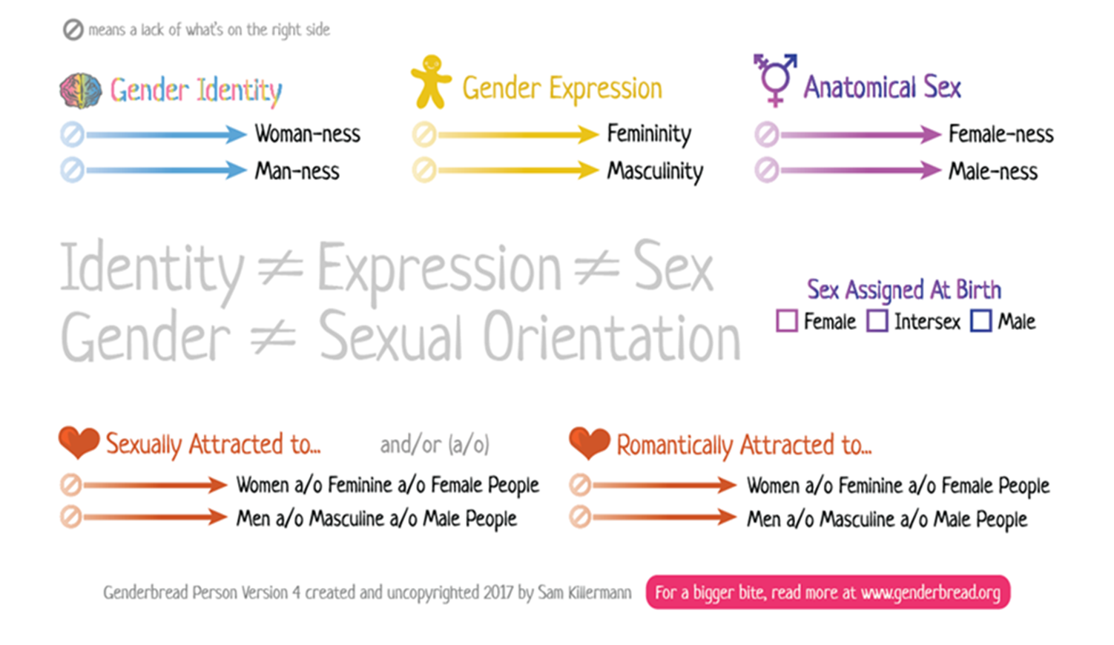
Notes:
> Gender Identity: Gender identity is an internal and individual experience of yourself that can include being a man or woman, both, neither or something else on the gender spectrum.
Your gender identity might be the same as the one you were assigned at birth or it might be different.
Gender identity is not the same as sexual orientation. Sexual orientation is about who you are attracted to.
> Gender Expression: This is how one engages with conventions and stereotypes associated with a specific gender to present their gender externally daily based on social conventions, which varies according to the time and place a social group lives in.
> Sexual orientation: A personal characteristic that encompasses emotional, romantic, or sexual feelings toward another person. It’s important to note that sexual orientation means the attraction felt for another and not sexual behaviour or someone’s sexual history.
Sex Assigned at Birth: A label attached to human beings when they are born and based generally upon genitalia or other physical characteristics.
Please note that “Sexual Preference” is no longer an accepted term because it implies a conscious choice. By using the term, sexual orientation, it reinforces who the person is and their personality trait.

Slide 4
Definitions
OPS Bilingual Glossary on gender identity
Transgender
Non-Binary
Transsexual
Refers to a person whose gender identity differs from the one associated with their birth-assigned sex.
Refers to a person whose gender identity does not align with the binary concept of gender such as man or woman.
A person who has a desire or has had treatment to make their physical appearance more consistent with their gender identity.
20% of the trans community have non-binary identities.
Notes:
TRANSGENDER
Refers to a person whose gender identity differs from the one associated with their birth-assigned sex.
Note:
The term "trans*" includes all transgender, non-binary, and gender non-conforming identities, while "trans" (without the asterisk) is used to describe trans men and trans women.
The terms "transgender" as a noun and "transgendered" are to be avoided.
TRANSSEXUAL
A person who has a desire or has had treatment to make their physical appearance more consistent with their gender identity.
NON-BINARY
Refers to a person whose gender identity does not align with the binary concept of gender such as man or woman.
People who do not identify within the gender binary of male/man or female/woman often prefer gender neutral pronouns such as they/their or titles such as Mx.
Fact:
20% of the trans community have non-binary identities.

Slide 5
Did you know?
11% of LGBTQ+ adults and 26% of youth are non-binary (Williams Institute/Trevor Project)
Non-binary youth who reported that “no one” respected their pronouns had more than 2.5x the rate of attempting suicide compared to those who reported that “all or most of the people” they know respected their pronouns (Trevor Project)
35% of youth know someone who uses gender-neutral pronouns (Pew research institute)
17% of youth assigned male at birth are non-binary (Trevor Project)
28% of assigned female at birth are non-binary (Trevor Project)

Slide 6
What is gender neutral language?
Gender-neutral language is language that avoids bias toward a particular sex or social gender.
You can refer to individuals without assuming their gender and without assuming they are men or women.
Notes:
Gender-neutral language is language that avoids bias toward a particular sex or social gender. There are a number of ways to avoid using gender-specific language. Many gender-specific terms may be replaced with gender-neutral terms that have the same meaning.
Gender-neutral language allows you to speak to and about individuals without making what might be incorrect assumptions about their gender. Just because someone sounds or appears feminine or masculine doesn’t mean they are a man or a woman, after all—they could be agender or non-binary, or simply differ from your expectations of what a man or a woman looks like.
Using gender-neutral pronouns allows you to include all people when you speak.

Slide 7
Why gender neutral language important?
Gender neutral language is important when communicating or writing about clients because it is more accurate, respectful and is consistent with the values of equality recognized in the Canadian Charter of Rights and Freedoms.
In 1985, the Government of Ontario adopted an official policy of using gender-neutral language in all official publications.
The purpose of gender-neutral language is to avoid word choices which may be interpreted as biased, discriminatory or demeaning by implying that one sex or social gender is the norm.
Notes:
Gender neutral language is important when communicating or writing about clients because it is more accurate, respectful and, is consistent with the values of equality recognized in the Canadian Charter of Rights and Freedoms.
In 1985, the Government of Ontario adopted an official policy of using gender-neutral language in all official publications
European Parliament guidelines for gender neutral language states: The purpose of gender-neutral language is to avoid word choices which may be interpreted as biased, discriminatory or demeaning by implying that one sex or social gender is the norm.

Slide 8
Using gender neutral language
Listen
Observe and listen to the client’s verbal cues;
Key words
Phrases
Mirror and Match
Identify one of the client’s key words you heard; and mirror it back when it is your turn to speak.
Ask questions
You may ask indirect questions such as;
can I refer to you by your first name?; or
how would you prefer that I address you?
Notes:
MILEN:
Observe and listen to the client’s verbal cues (key words and phrases). Identify one of their key words you heard, and mirror it back to them when it is your turn to speak.
If it is necessary for the task at hand, you may try an indirect question, such as, “how would you prefer that I address you?” - hoping they indicate a title (Mr., Ms., Mrs., etc.) or a pronoun that gives you a cue on which you can act.
Don’t feel like you can’t apologize if there is a miscue. You can say “I am sorry, thanks for letting me know the pronouns you use, or the name you prefer me to use,’
People like it when you use pronouns that they use for themselves.”

Slide 9
Gender neutral pronouns
When you must use a gender specific pronoun, use the term preferred or considered appropriate by the client. In English, the terms below are used:
They
Them
Their
You
However, the French language does not offer this flexibility (however, there are folks working on it! In November 2021, the widely used French dictionary Le Robert added the non-binary pronoun “iel” to its online edition)
A brief article on the progress being made with respect to the French language and pronouns: https://blog.lingoda.com/en/french-gender-neutral-pronouns/
Your listening skills are key and the best option is to mirror the client during the interaction.
Notes:
In the English language, neutral terms such as they, them, themselves, their are used however the French language does not offer this flexibility. Your listening skills are key and the best option is to mirror the client during the interview.
“They” “Them” “Their” and “You” are the most commonly used gender-neutral pronouns—in fact, you probably already use “they” in your everyday language without thinking about it. Before you ask: yes, it is appropriate to use “they” as a singular pronoun. Even though “they” can be used as a plural pronoun (i.e. to refer to a group of people), people tend to automatically use “they” as a singular pronoun when they don’t know someone’s gender. “They” is also one of the more popular pronouns used by people who are agender or non-binary.
He/She is not gender neutral

Slide 10
Gender neutral terms
Instead of | Use
She/He/Herself/Himself Her/Him Hers/His | They, Themself Them Theirs
Husband/wife | Spouse, partner, other party, any person (or any number of less formal, gender neutral alternatives)
Common law husband/wife | Spouse, partner, other party, any person (or any number of less formal, gender neutral alternatives)
Daughter/son | Child/children/offspring (or any number of less formal, gender neutral alternatives)
Notes:
This chart includes some examples of gender neutral terms that you can use to replace gender-specific terms that have the same meaning.
use "they" and its other grammatical forms ("them", "themselves" and "their") instead of “he” or “she”.
(for example instead of “is she willing to try mediation” use “are they willing to try mediation”)
replace “husband“ or “wife” with a neutral word or phrase such as “spouse” “partner” "person", "any person", "every person" or "no person“
(for example, instead of “your wife must sign a consent and declaration form” use “your spouse must sign a consent and declaration form”)
using “child” instead of daughter or son. (for example use “is the child is residing with other party, instead of is your daughter residing with her mother”)
In addition to using gender inclusive language when interacting with clients, it is also important to use gender neutral language when adding notes in PeopleSoft.

Slide 11
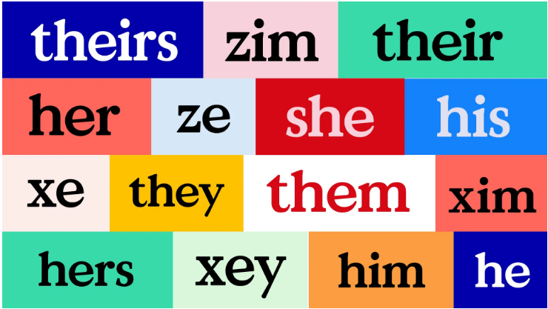
THE RICHNESS OF PRONOUNS
There are more pronouns than you may think…

Slide 12
Avoid assumptions
Are you making any unconscious assumptions about a person’s gender based on their name?
Consider the long list of gender neutral (unisex) names you are already familiar with…
Are you speculating that gender based on the person’s name or tone of voice?
Instead of making assumptions:
Ask a person or client about their gender identification.
Rework anything that ignores or may ignore diversity in order to establish rapport with individuals.
Be sensitive to differences.
Avoid using Miss/Mrs./Mr. unless the person expressly indicates that they wish to be addressed in this manner.
Notes:
Ask yourself about unconscious assumptions you may have made about a client “Are you making assumptions about gender based on the person’s name or tone of voice? Are you speculating that gender based on the person’s name or tone of voice?” Rather than make assumptions, ask the client about their gender identification.
Rework anything that ignores diversity or might in order to establish rapport with the clients. Be sensitive to differences. Avoid using Miss/Mrs./Mr. unless the client expressly indicates that they wish otherwise.

Slide 13
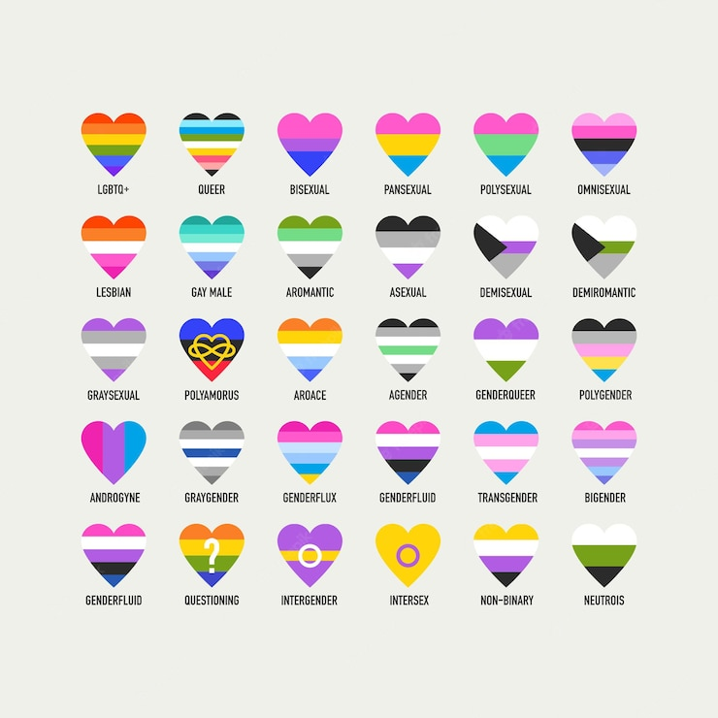
LGBTQ+ flags
Notes:
There are almost just as many flags as identities.

Slide 14
Original Pride flag - Transgender Pride flag - Progress Pride flag
Notes:
Here are three important ones:
Original Multi-Coloured Rainbow Flag was designed in 1978.
Transgender Pride Flag (white, pink, and light blue stripes) designed by transgender activist in 1999
The Progress Pride Flag incorporates both the original Pride Flag and the Transgender Pride Flag and was done in 2018
The flag’s black and brown stripes represent marginalized LBGT communities of colour, community members lost to HIV/AIDS, and those currently living with AIDS

Slide 15
