Slide 1
COGNITIVE bias AND YOU
October 2022 – Shereen Samuels and Roberto Aburto

Slide 2
Land acknowledgement

Slide 3
Agenda
Topic | Speaker
FACILITATOR INTRODUCTIONS | Roberto and Shereen
LET’S TALK ABOUT OUR BRAINS | Roberto
ARE YOU BIASED? | Video
THE COGNITIVE BIAS CODEX/ SOME COMMON COGNITIVE BIASES | Shereen
WHAT CAN YOU DO TO MITIGATE COGNITIVE BIAS | Roberto
QUESTIONS | Roberto and Shereen

Slide 4
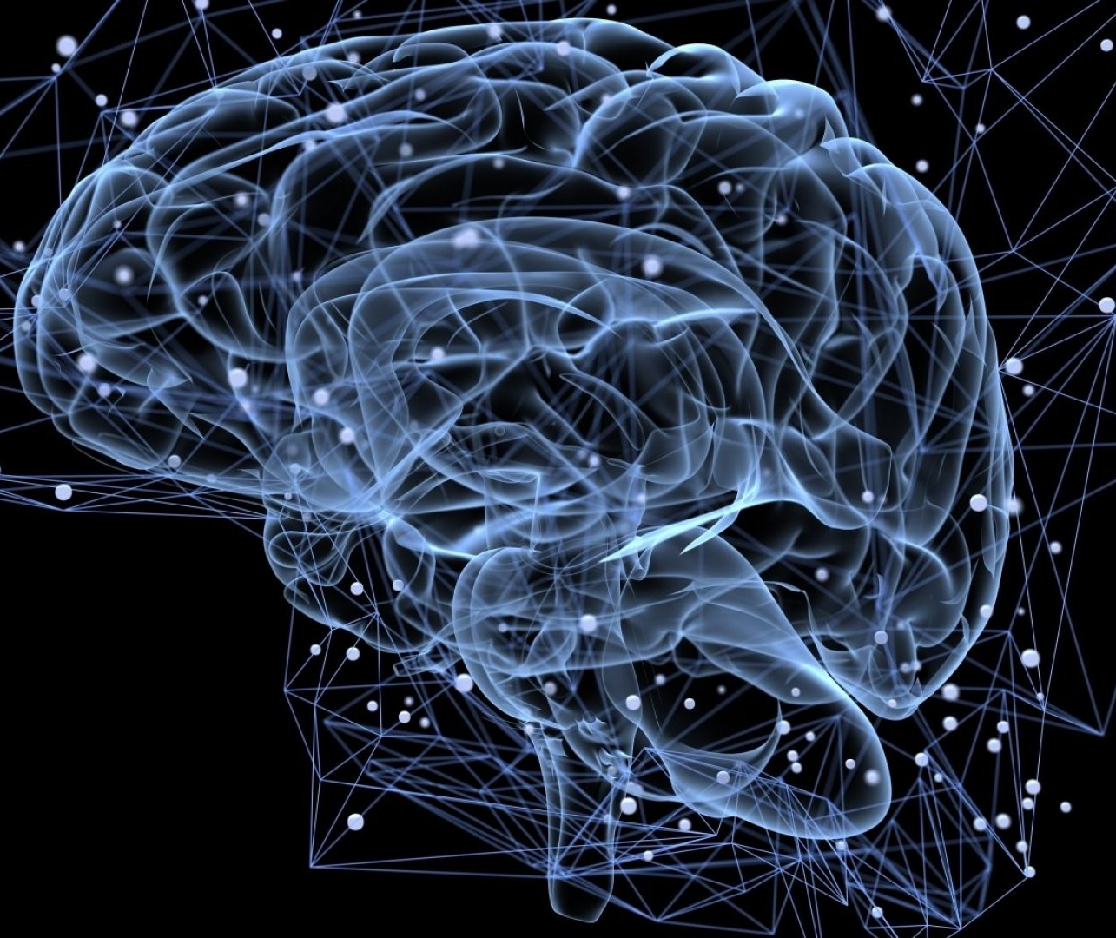
Let’s talk about our brains
OUR BRAINS WORK TO CREATE MEANING UNDER PRESSURE
  WE NEED TO ACT FAST
  WE HAVE TOO MUCH DATA
  WE HAVE TOO LITTLE MEANINGFUL DATA
  WE NEED TO KNOW WHAT TO REMEMBER
INCREASINGLY WE ARE UNDER A CONSTANT COMBINATION OF ALL FOUR PRESSURES
OUR BRAINS CREATE SHORTCUTS THAT CAN INTRODUCE ERRORS INTO OUR THINKING

Slide 5
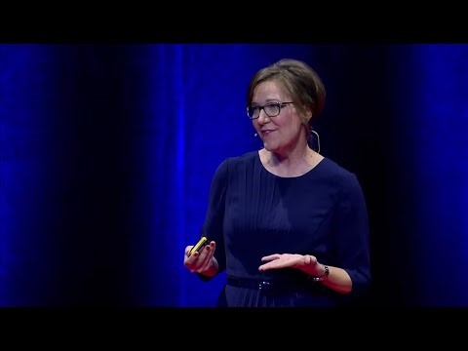
Are you biased?

Slide 6

Cognitive shortcuts quiz
  Arnold is a shy, highly organized Canadian man.
  Is he more likely to be a librarian or a farmer?
  Librarian
  Farmer

Slide 7
Cognitive shortcuts quiz
  Arnold is a shy, highly organized Canadian man.
  Is he more likely to be a librarian or a farmer?
  Librarian
  Farmer

Slide 8
Cognitive shortcuts quiz
  Which of the following messages reduced energy use most among residential consumers?
  Save money
  Save the planet
  Be a good citizen
  Your neighbours are doing better

Slide 9
Cognitive shortcuts quiz
  Which of the following messages reduced energy use most among residential consumers?
  Save money
  Save the planet
  Be a good citizen
  Your neighbours are doing better

Slide 11
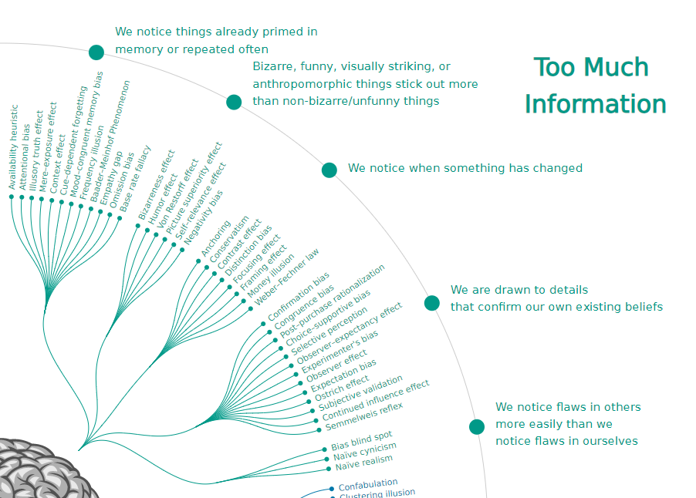
CONFIRMATION BIAS
The tendency to search for, interpret, favour, and recall information in a way that confirms or supports one's prior beliefs or values.
NAÏVE REALISM
The tendency to believe that we see the world around us objectively, and that people who disagree with us must be uninformed, irrational, or biased.
SELECTIVE PERCEPTION
A procedure by which people let in, or screen out, incoming information based on pre-existing attitudes, beliefs, usage preferences and habits.

Slide 12
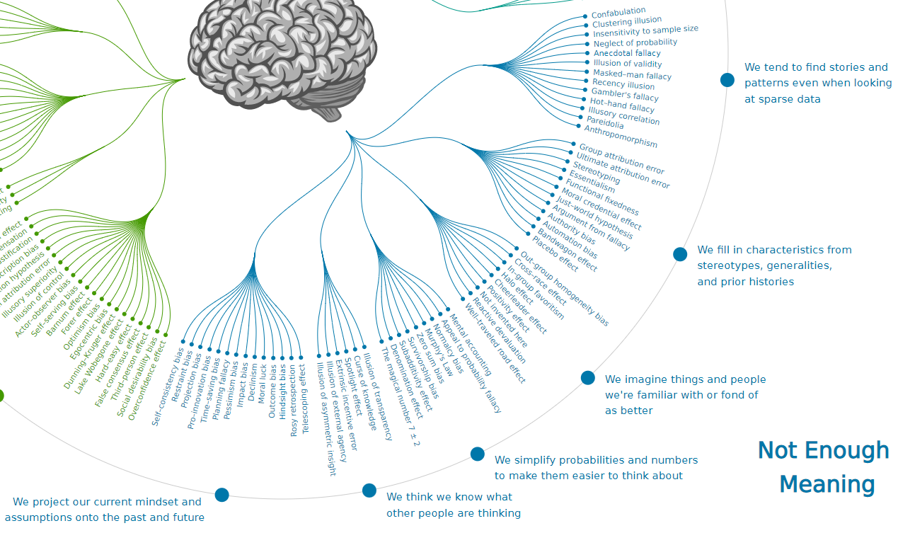
ESSENTIALISM
The belief that objects have a set of attributes that are necessary to their identity.
ANECDOTAL FALLACY
Conclusions derived only from personal observation, collected in a casual or non-systematic manner.
HALO/HORNS EFFECT
The tendency to extrapolate a positive or negative impression in one area to other contexts.

Slide 13
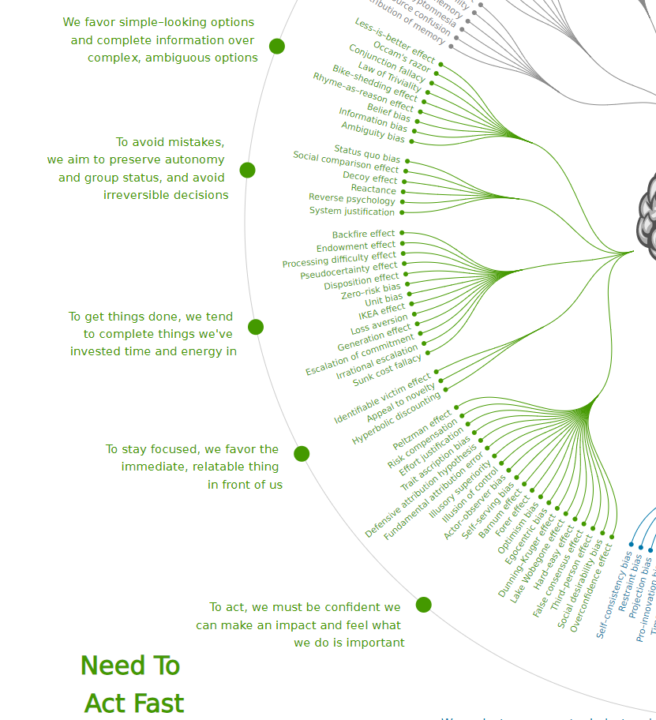
IDENTIFIABLE VICTIM/PERPETRATOR EFFECT
The tendency of individuals to offer greater aid when a specific, identifiable person ("victim") is observed under hardship, as compared to a large, vaguely defined group with the same need. Research has shown that individuals can be more likely to mete out punishment, even at their own expense, when they are punishing specific, identifiable individuals ("perpetrators").
FUNDAMENTAL ATTRIBUTION ERROR
The tendency to believe that what people do reflects who they are.
REACTANCE
A negative reaction that occurs when someone is pressured into accepting a certain view or behaviour. Reactance can encourage an individual to adopt or strengthen a response of noncompliance — and can also increase resistance to persuasion.

Slide 14
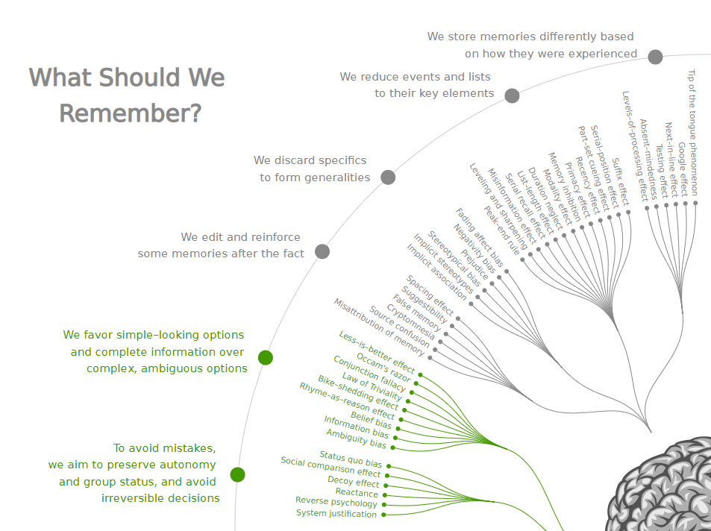
MISINFORMATION EFFECT
The new information that a person receives works backward in time to distort memory of the original event.
SYSTEM JUSTIFICATION
A tendency to hold favourable attitudes about oneself (ego-justification), the groups to which one belongs (group-justification), and about the overarching social structure in which they are entwined (system-justification).

Slide 15
Confirmation bias
Naïve realism
Selective perception
Misinformation effect
System justification
WHEN HAVE YOU SEEN THESE IN ACTION?
Identifiable victim/perpetrator effect
Fundamental attribution error
Reactance
Essentialism
Anecdotal fallacy
Halo/horns effect

Slide 16

IF YOU HAVE A BRAIN, YOU HAVE BIASES
A bias is a mental shortcut that influences decisions and behaviours
Over time, our mental shortcuts become routine and we can mistake them for robust thinking – leading us to have blind spots
Beware of moments of personal vulnerability
Dedicate time and effort to mitigating strategies
Accept susceptibility to bias
Care about the impact of bias
Expect challenge from others

Slide 17
The nudge framework helps design and implement effective nudges
A nudge is a “mental push” that helps address behavioural change by disrupting things we think and do unconsciously
  To develop nudges, consider what you want to target and decide on scope
Raise
awareness
Modify the process
Reframe
the issue

Slide 18
Wrap up

Slide 19
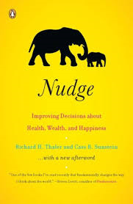
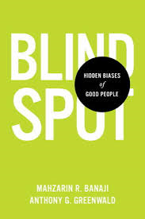

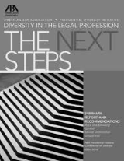
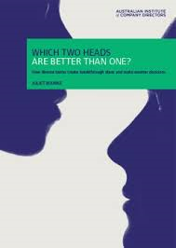

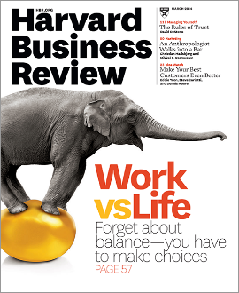
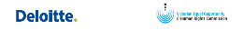
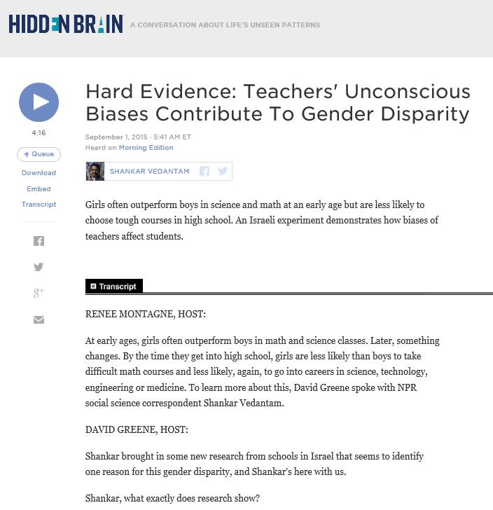
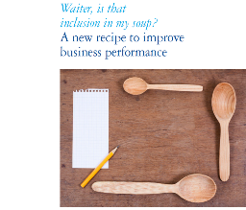
Want to know more? Books, articles, and videos on unconscious bias
 | Nudge: Improving Decisions About Health, Wealth, and Happiness by Richard H. Thaler and Cass R. Sunstein
 | Affinity bias in the Legal Profession by Stella Tsai and Debra Rosen
 | Fear of Being Different Stifles Talent by Kenji Yoshino and Christie Smith, HBR article
 | Blindspot: Hidden Biases of Good People by Mahzarin R. Banaji and Anthony G. Greenwald
 | Which Two Heads Are Better Than One? by Juliet Bourke
 | Waiter, is that Inclusion in my soup? A New Recipe to Improve Performance Deloitte
 | Project Implicit Association Test Harvard University
 | NPR podcast on the role of racial bias in the sharing economy
 | NPR podcast on role of gender bias in teaching/learning

Slide 20
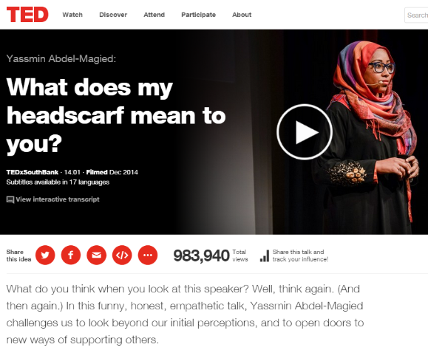
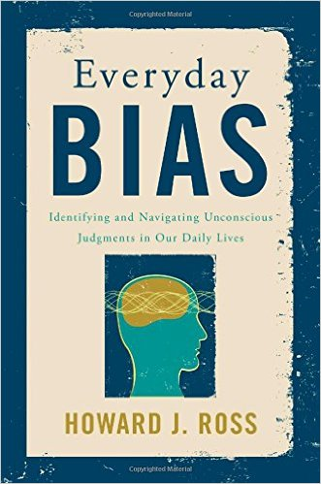
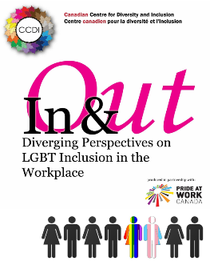
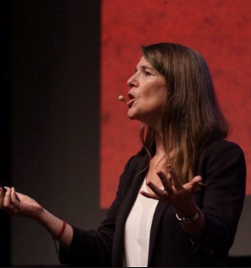

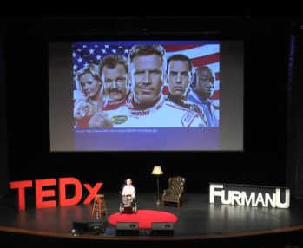
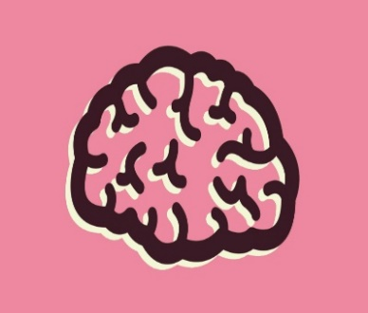


Want to know more? Books, articles, and videos on unconscious bias (continued)
 | What Does My Headscarf Mean to You? by Yassmin Abdel-Magied
 | Diversity of Thinking by Juliet Bourke
 | How Corporate America is Tackling Unconscious Bias Fortune Magazine
 | Everyday Bias: Identifying and Navigating Unconscious by Howard J. Ross
 | The motherhood penalty The Globe and Mail by Anne-Marei Slaughter
 | Handbook of Race, Racism and the Developing Child by Stephen M. Quintana and Clark McKown
 | In & Out: Diverging Perspectives on LGBT Inclusion in the Workplace by CCDI
 | Covering at Work by Christie Smith
 | ’Whitening’ the Resume New York Times, 2009

