Slide 2
The information contained in this presentation is for educational purposes only. This information is not legal advice. If you have questions or a legal issue you should consult a lawyer.

Slide 3
Common Landlord Notices
Agreement to End the Tenancy (N11)
Notice to End Your Tenancy Because the Landlord, a Purchaser or a Family Member Requires the Rental Unit (N12)
Notice to End your Tenancy Because the Landlord Wants to Demolish the Rental Unit, Repair it or Convert it to Another Use (N13)

Slide 4
Buying as a Landlord
Want a copy of any Notice that has been served on the Tenant
Want confirmation that compensation (if required) has been paid to the Tenant
Want a copy of any lease agreement that exists
Want tenant acknowledgment

Slide 5
Selling as a Landlord
Want the Purchaser to assume the tenancy
Want an indemnity from the Purchaser
Want an adjustment on closing in favour of the Vendor for any compensation paid to the Tenant (if compensation is required)
Potentially ask for a holdback
Want to see the draft affidavit/declaration for the person moving into the unit, before the N12 notice is served

Slide 6
N11
Agreement to End the Tenancy
Can apply to the Board immediately after the N11 is executed by the Landlord and Tenant
Provide the Tenant with a copy of the signed N11
Earliest eviction date available is the Termination Date in the N11
Tenant cannot be forced to sign this agreement or be asked to sign the agreement when entering into the tenancy
When filing with the LTB a declaration or affidavit must be completed by the Landlord and contain specific statements
Typically able to obtain eviction Order without a hearing
Application to End a Tenancy and Evict a Tenant; Tenant Gave Notice or Agreed to End the Tenancy (L3 Form)

Slide 7
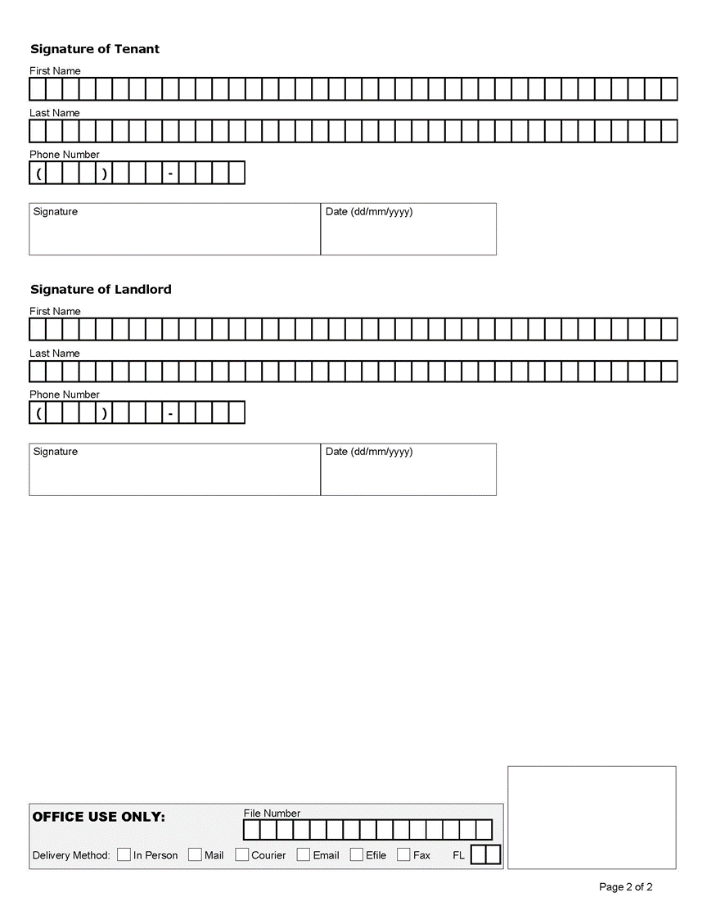

Slide 8
N12 Notice
Notice to End Your Tenancy Because the Landlord, a Purchaser or a Family Member Requires the Rental Unit (N12)
Must be served in good faith
Must provide an affidavit or declaration sworn by the person planning to move into the unit when filing with the LTB
Declaration must contain certain statements
Two reasons it can be served:
Personal Use by the Landlord or Landlord’s Family (section 48 of the RTA for when this reason can be used)
Personal Use by a Purchaser or Their Family (section 49 of the RTA for when this reason can be used)
Must compensate the tenant in an amount equal to one month's rent or offer another rental unit acceptable to the tenant
60 days notice
Application to End a Tenancy and Evict a Tenant or Collect Money (Form L2)

Slide 9
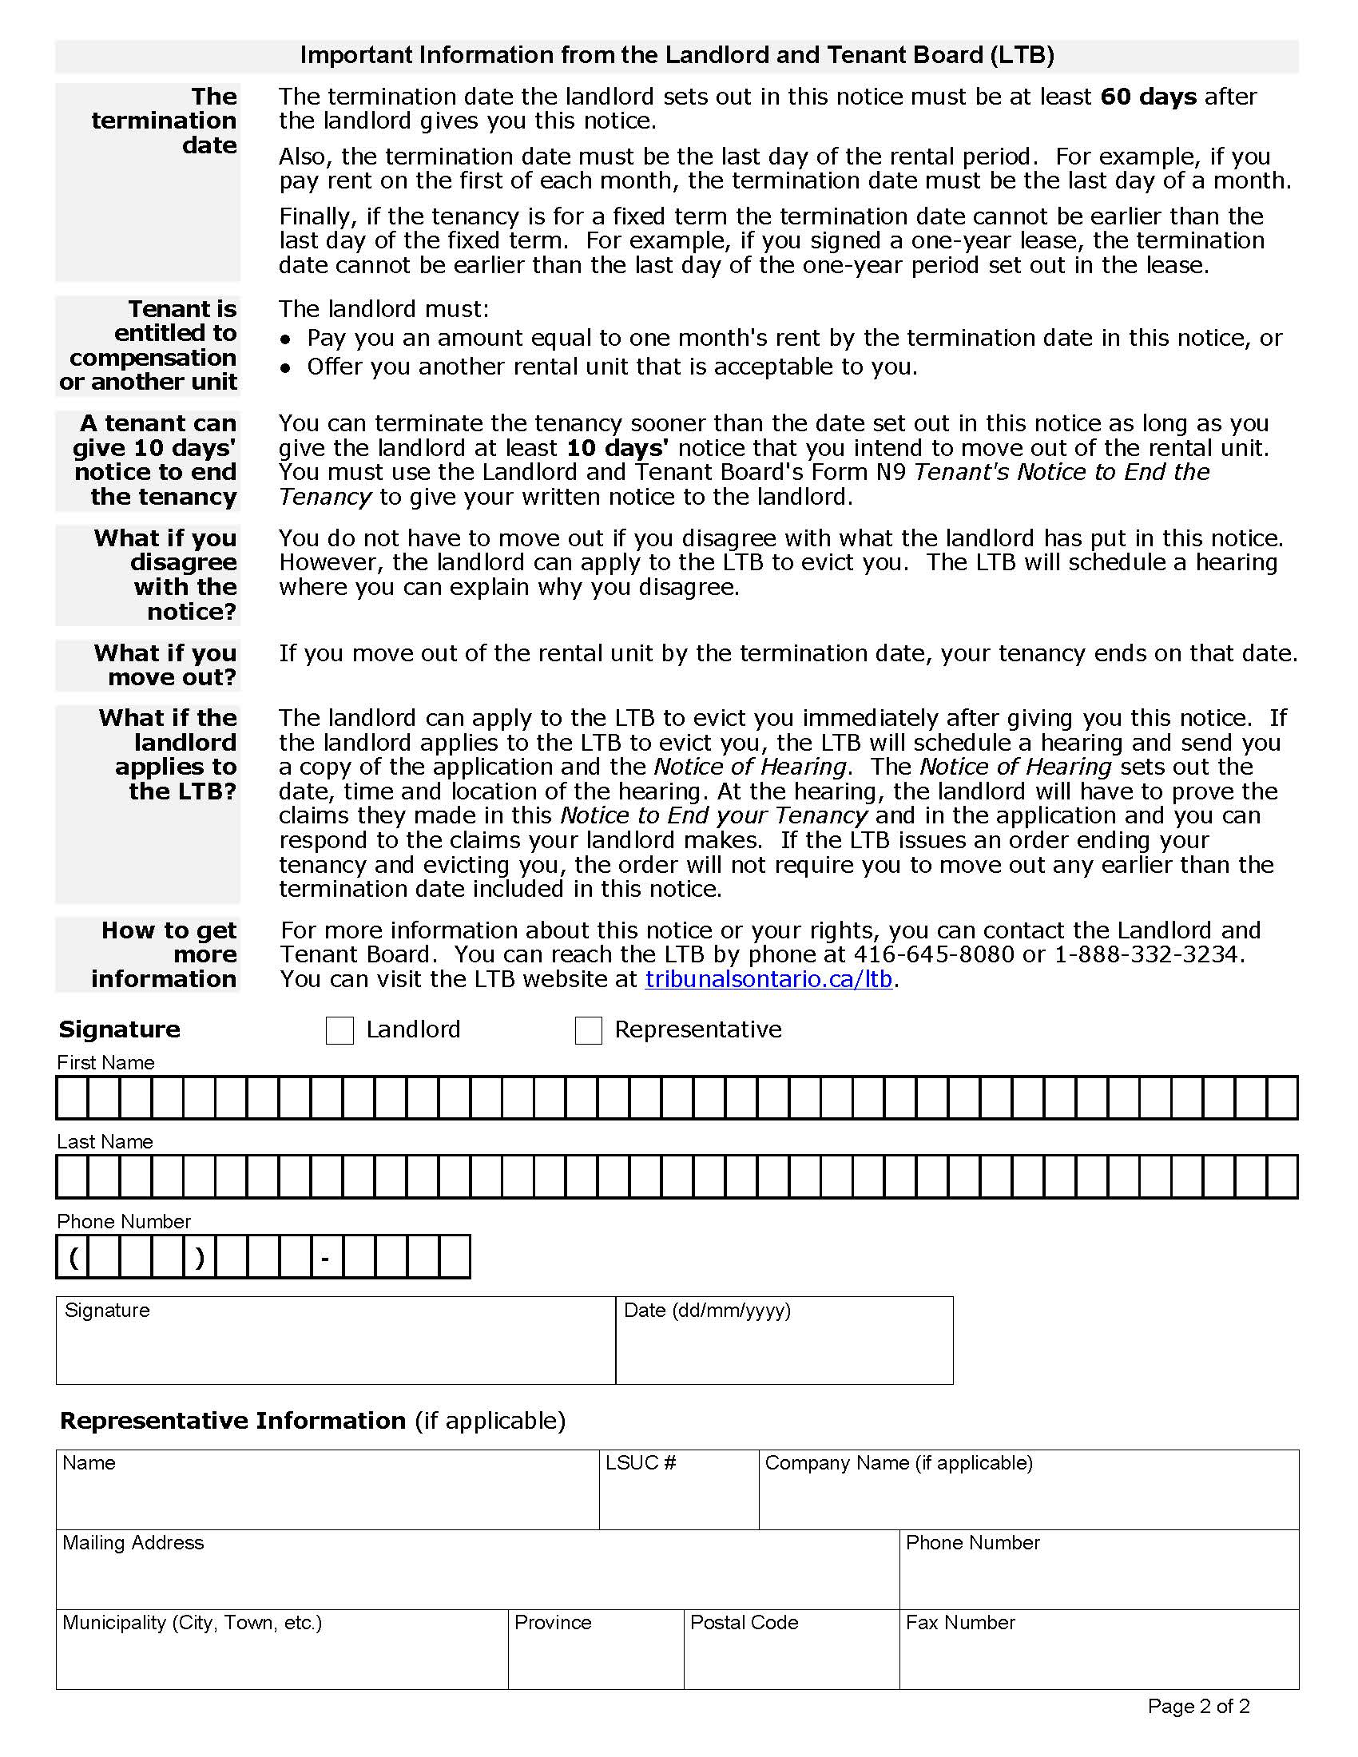

Slide 10
N13 Notice
Notice to End your Tenancy Because the Landlord Wants to Demolish the Rental Unit, Repair it or Convert it to Another Use (N13)
Landlord must prove (on a balance of probabilities) that they intend in good faith to carry out the activity in the N13
Three reasons that the N13 can be served:
You intend to demolish the rental unit or complex
You need the rental unit to be vacant in order to do extensive repairs or renovations
You intend to convert the rental unit or complex to non-residential use
Must pay compensation to the Tenant or offer the Tenant another rental unit that is acceptable to the Tenant
Amount of compensation depends on the number of residential units in the residential complex
Compensation for a mobile home or land lease is different
Compensation is not required when the Landlord has been order to demolish, repair or renovate
120 days notice
1 year notice for mobile homes or land leases
Special rules for care homes
Application to End a Tenancy and Evict a Tenant or Collect Money (Form L2)

Slide 11
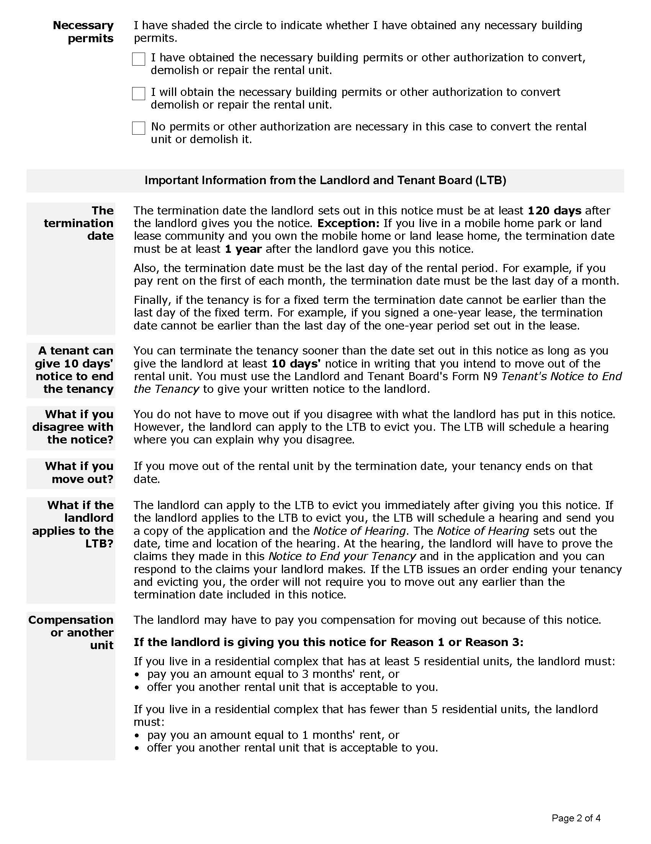

Slide 12
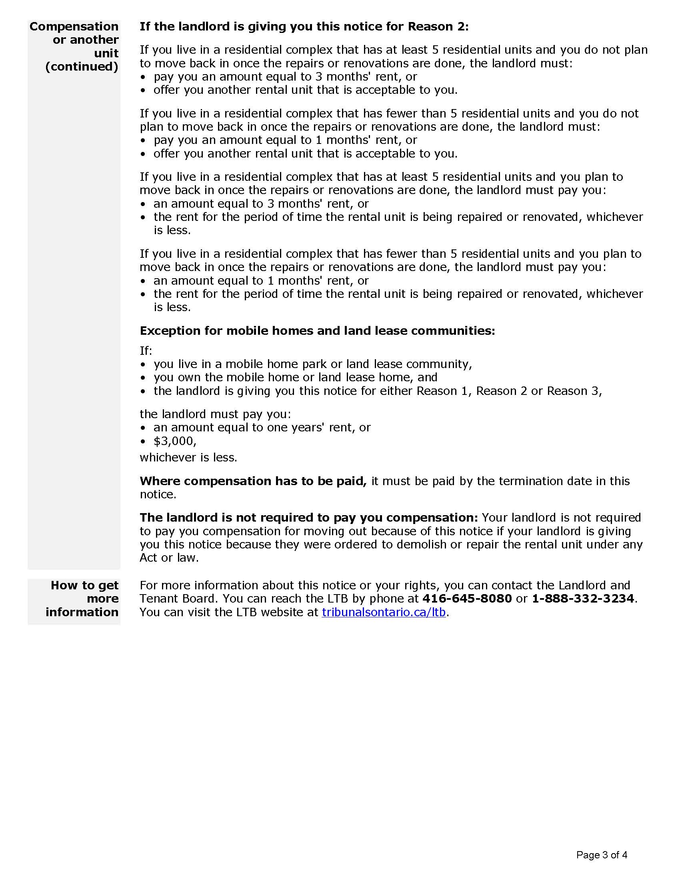
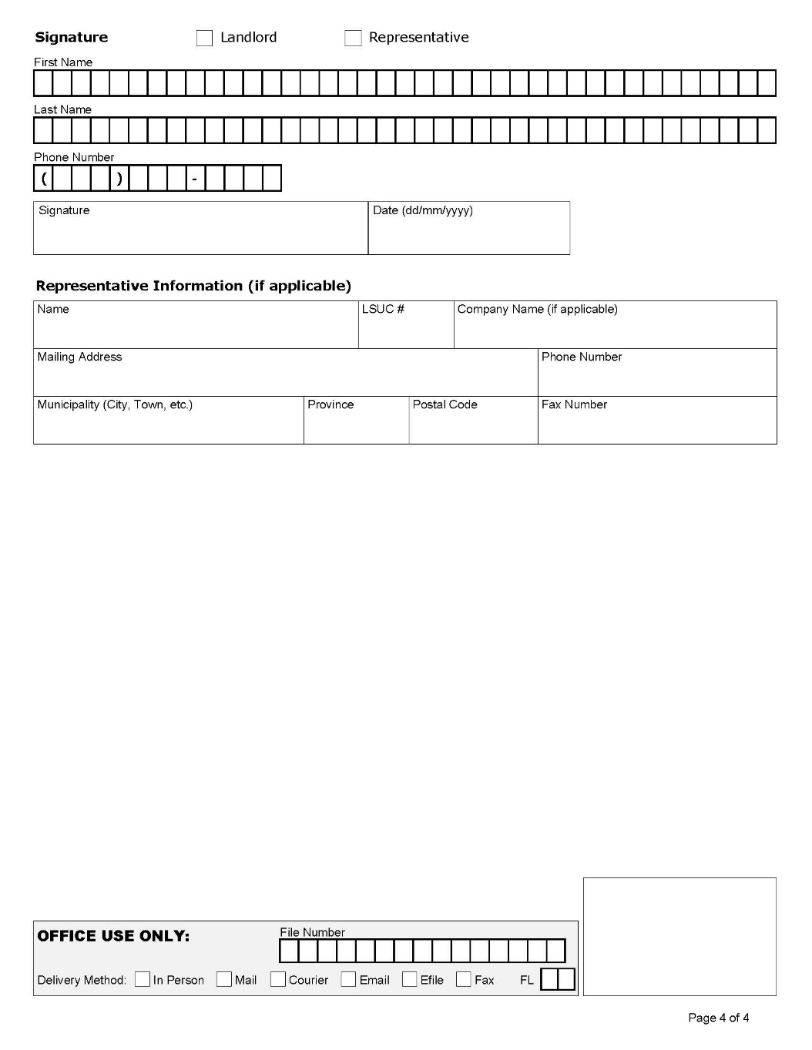

Slide 13
Good Faith
The Board may make an Order based on a former Tenant’s application where the Tenant alleges a notice was given in bad faith, and:
The Landlord gave the Tenant a notice under sections 48, 49 or 50 in bad faith; and
The Tenant moves out of the unit because of the notice, an application to the LTB or an order based on the notice; and
No one has moved into the unit within a reasonable time after the Tenant moved out, or the Landlord did not demolish, convert or repair or renovate the rental unit within a reasonable time.
There is a presumption that an N12 Notice was given in bad faith, unless the contrary is proven on a balance of probabilities, if the Landlord:
advertises the rental unit for rent;
enters into a tenancy agreement in respect of the rental unit with someone other than the former tenant;
advertises the rental unit, or the building that contains the rental unit, for sale;
demolishes the rental unit or the building containing the rental unit; or
takes any step to convert the rental unit, or the building containing the rental unit, to use for a purpose other than residential premises.
*This provision only applies for the period that begins on the date that the Landlord gave the notice and ends one year after the former Tenant moves out

Slide 14
Notice Issues
Termination Date is invalid
Name or address is missing
Notice is unsigned or undated
Notice was not served properly
Application is filed too late
Not using the actual LTB notices
Wrong notice is used
Special rules for mobile homes, land lease communities and care homes

Slide 15
Tenant Applications
Application about Tenant Rights (T2 Form)
Landlord Gave a Notice of Termination in Bad Faith (Form T5)
Tenant Application about Maintenance (Form T6)

Slide 16
Application Problems and Board Remedies
Dismissal of Application
Refuse or delay eviction
Order for Costs
Rent Abatement
Administrative Fine
Compensation
Reasonable out of pocket expenses
Compensation for increased rent and reasonable moving expenses
Ontario Rental Housing Enforcement Unit Complaint and Investigation

Slide 17
Timeline for a Hearing
Automatic Reply Email
“PLEASE NOTE:
Thank you for contacting the Landlord and Tenant Board. Please note that it is currently taking us longer than usual to process applications and schedule hearings. Current processing times are approximately 7-8 months.
If you have a file number or have been issued a one-time PIN number, you can check the status of your file on our website. If your file number begins with LTB (e.g. LTB-L-000420-21) then you must log on to the Tribunals Ontario Portal. If your file does not begin with LTB (e.g. TSL-00123-09), you can check the status of your file at LTB: Check File Status | Tribunals Ontario.
If you submitted your application more than 7-8 months ago and have not yet been provided with a file number, you can reach out to the LTB Contact Centre or send an inquiry by email to your regional office ensuring to provide your name and the rental unit address.”

Slide 18
Questions?

