Slide 1
Transfers for No Consideration
Colloquium Legal Conference - October 20-21, 2022
Bryan Gilmartin

Slide 2
Attorney for Property Misuse Scenario
Irma is an older adult who was found incapable of managing her property. Her attorney for property is her son, Erwin.
Erwin used $82,000 of Irma’s money to purchase a house in his name.
Erwin’s siblings have expressed concern that their brother is using Irma’s savings for his benefit. Erwin insists he bought the house for Irma to live in.
Erwin’s characterization of the $82,000 was inconsistent, at various points calling it an “investment”, a “loan”, and a property held “in trust”. There were no loan documents or trust deeds associated with the property.
Did Erwin misuse his power as Irma’s attorney for property?

Slide 3
Attorney for Property Misuse Scenario
Did Erwin misuse his power as Irma’s attorney for property?
YES – In The Estate Of Irmgard Burgstaler (disability), 2018 ONSC 1187
Erwin breached his fiduciary duty to act in Irma’s best interest when he took the $82,000 from her bank account, and bought a property registered in his name alone
“As a fiduciary, Erwin was obligated to act only for Irmgard’s benefit, putting his own interests aside … Erwin is not permitted to put himself in a position where his interests and his duty to Irmgard conflict”

Slide 4
Power of Attorney for Property
Individuals have freedom to sell, transfer, or mortgage their property
What happens if an individual loses capacity?

Slide 5
Continuing Power of Attorney for Property
SOME TERMS:
CPOAP:
A document that details the scope and powers a Grantor grants their Attorney
Grantor:
The person who grants certain decision making powers to another under a formal document.
Attorney:
The person to whom the Grantor grants decision making powers.
KEEP IN MIND…
Power of Attorney Documents are governed by the Substitute Decisions Act and common law fiduciary duty
A CPOAP is effective from date it is executed until it is revoked
A CPOAP relates only to the Grantor during their lifetime, upon the Grantor’s death the CPOAP is inoperative

Slide 6
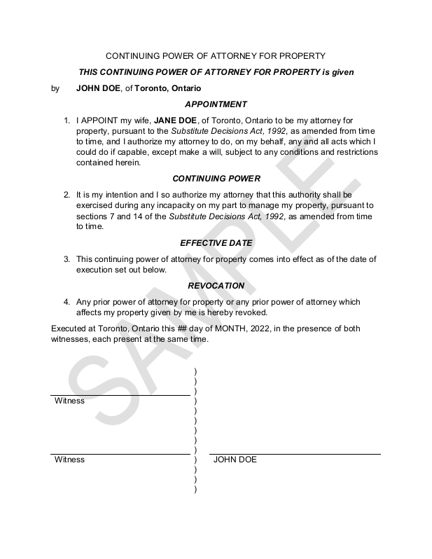
Ascertaining validity of a CPOAP
When making a CPOAP, a Grantor….
MUST…
be at least 18 years old
be capable of granting a CPOAP
properly execute the CPOAP with the requisite two witnesses and their signatures and clarity as to the document being “continuing”
NEED NOT…
adhere to any particular form
be capable of managing his or her property
Continued….

Slide 7
Ascertaining validity of a CPOAP
Proper execution of a CPOAP
Generally: the CPOAP document must…
State that it is a Continuing Power of Attorney
OR
Express the intention that the authority given may be exercised during the Grantor’s incapacity to manage property
Be witnessed
AND
Signed by those two witnesses
+
Continued….

Slide 8
Capacity in General
There is no single legal definition for “capacity”
No single “test” for capacity, not really a test
Capacity is
DECISION specific;
TIME specific;
SITUATION specific;
Capacity may FLUCTUATE

Slide 9
Inter Vivos Gift
During one’s lifetime, different sizes, small portion of assets or entire life savings (different than testamentary = always all assets)
Ball v Mannin: understand the nature and effect of the transaction, if given full explanation of basic terms

Slide 10
Inter Vivos Gifts: Size
Size of gift matters:
gift that is significant in value in relation to donor’s estate = testamentary capacity
Petrowski v Petrowski 2009 ABQB 196 – all gifts?

Slide 11
Authorizing a Transfer under a POA
Participation of lawyers in a transfer of property is mandatory
Statement by Attorney for Property required
Statement by solicitor confirming they have reviewed the POA with the Attorney

Slide 12
Responsibilities of Solicitors for Sellers and Buyers
SELLERS
Obtain original or authenticated copy of POA
Be informed as to details of its use,
Understand what becomes of funds
BUYERS
Review the agreement of purchase and sale for indication transaction being completed using POA
Obtain authenticated copy of POA; ensure POA executed in accordance with statutory requirements

Slide 13
Financial exploitation through use of a CPOAP
An Attorney for Property misuses / abuses a grantor’s property when.…
steals the grantor’s money, pension cheques, or possessions
commits fraud, forgery or extortion
makes unauthorized, questionable or even speculative investment decisions, or investment decisions lacking diversity
fails to consider the tax effects of actions or inactions
inappropriately deals with jointly held assets or accounts
misappropriates the grantor’s assets
shares the grantor’s home without paying a fair share of the expenses
withholds from the grantor bank statements/other financial documents
denies the grantor access and/or control over finances (e.g., credit cards, cheques)

Slide 14
Financial exploitation through use of a CPOAP
“MISSAPPROPRIATE” VS “STEALING”
To “misappropriate” means to dishonestly or unfairly take something, especially money, belonging to another for one's own use
To “steal” means to take another person's property without permission or legal right and without intending to return it
VS.

Slide 15
Financial exploitation through use of a CPOAP
An Attorney for Property misuses / abuses a grantor’s property when.…
unduly pressures the grantor to:
sell personal property
move from/sell grantor’s home
Invest/withdraw money
buy alcohol/drugs
Make/change a Will
sign legal documents they do not understand including documents that transfer assets into joint names
give money to relatives, caregivers or friends; and/or
engage in paid work to bring in extra money

Slide 16
Undue Influence
The doctrine of undue influence can be used to set aside certain transactions like inter vivos gifts, wealth transfers, and testamentary documents where through the exertion of influence of the mind of the donor, the mind falls short of being wholly independent

Slide 17
Unconscionable Procurement
The doctrine of unconscionable procurement is used to set aside significant gifts and other inter vivos wealth transfers where the maker did not fully appreciate the effect, nature, and consequence of those transactions.

Slide 18
Red Flags & Best Practices:
Intellectual impairment, memory problems, disorientation, poor attention
Unaware of risks to self and others
Irrational behavior, reality distortion: delusions
Unresponsive and inability to make a decision
Cannot easily identify assets or family members
Made any recent gifts? Significant?
Medical events or health changes?
Client’s opinions tend to vary?
Any medical opinions?
Physical impairment?
Communication issues – language barriers?

Slide 19
Steps to Avoid Undue Influence
Clear indication in notes re capacity
Detailed & thorough notes
Interview client alone / probing questions
Make checklists
Trust your instincts: consider declining retainer
Mindful of Code of Conduct

Slide 20
WEL Partners Resources
Fiduciary Accounting: http://welpartners.com/resources/WEL-on-fiduciary-accounting.pdf
Guardianship: http://welpartners.com/resources/WEL-on-guardianship.pdf
Powers of Attorney: http://welpartners.com/resources/WEL-on-powers-of-attorney.pdf
Dependants’ Support: http://welpartners.com/resources/WEL-on-dependants-support.pdf
Elder Law: http://welpartners.com/resources/WEL-on-elder-law.pdf

Slide 21
Questions & Contact Information
45 St. Clair Ave. West, Suite 600 Toronto, Ontario, M4V 1K9
Main Telephone: (416) 925-7400 Facsimile: (416) 925-7464
https://welpartners.com

